Slide 1
Meeting Week 23
Last week summary
  System, model
Augmentation
  Issue stiffness matrix
  Description implementation
  New data
  Open-loop problem?
  Joint estimation
Outline ToDo next week

Slide 2


Slide 3


Slide 4
Initial problem
After initialization immediate blow up → factor 100 worse
Issue stiffness matrix K only positions for Theta (X, Theta, Y)
K = [0, 0, 0;
0, kb1+kb2, 0;
0, 0, 0]
Resulted in ANN correction accumulating over my simulation steps without demping

Slide 5
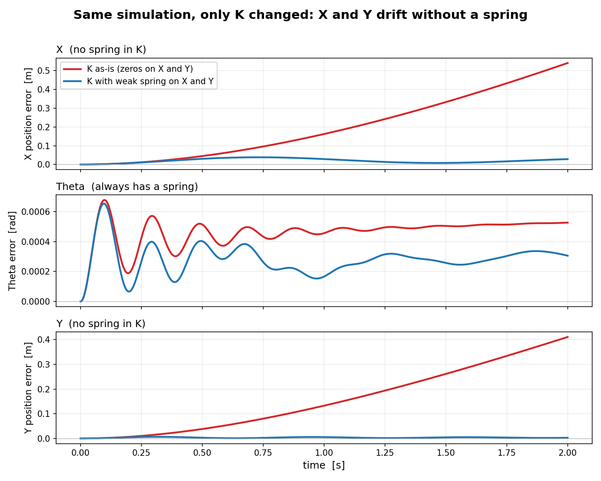
K = [0, 0, 0;
0, kb1+kb2, 0;
0, 0, 0]
Kb1+kb2 = 3975
Comparison:
K = [1000, 0, 0;
0, kb1+kb2, 0;
0, 0, 1000]
Open-loop run over full trajectory: sim-RMS
→ So only initial state

Slide 6
Previously I solved this with a trainable C matrix for augmentation (C_aug) for the output (y = Cd @ x_phys + C_aug @ x_aug)
  Didn’t blow up, but states also didn’t learn anything
Asked Jan for advice
  → Only augment states with a spring → Theta

Slide 7
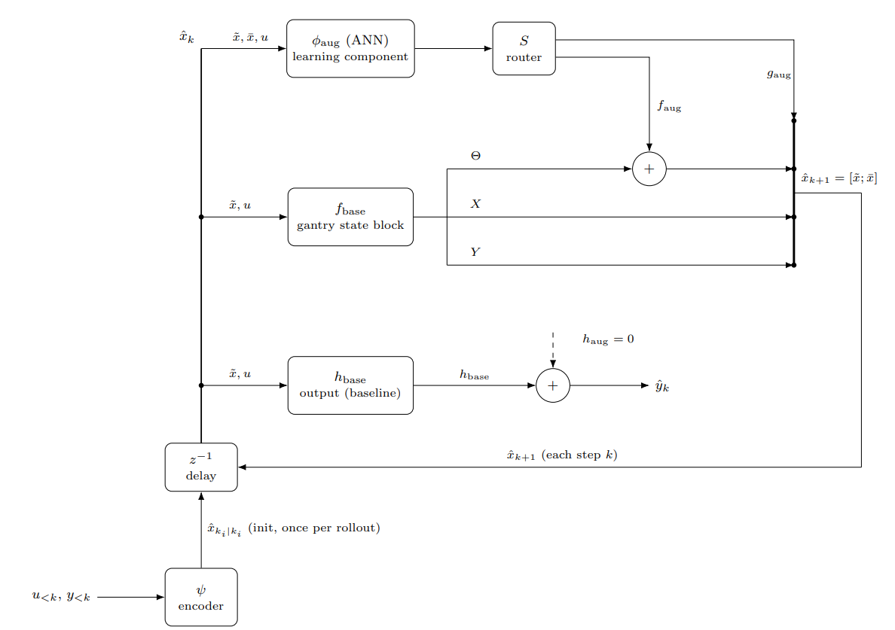

Slide 8
Question
For correct augmentation the ANN needs to be able to enter X and Y, how do I work around this stiffness matrix K issue?
  Due to coupling I need to be able to route the ANN through X and Y aswell (off-diagonal terms)

Slide 9
Results
=== Test-set sim-NRMS + RMS - generalization to unseen excitation ===
augmented baseline FP improve
(NRMS RMS [m]) (NRMS RMS [m])
X1: 0.0023 1.376e-04 m 0.0047 2.816e-04 m +51.1%
X2: 0.0018 1.162e-04 m 0.0044 2.803e-04 m +58.5%
Y : 0.0023 5.225e-04 m 0.0080 1.853e-03 m +71.8%

Slide 10
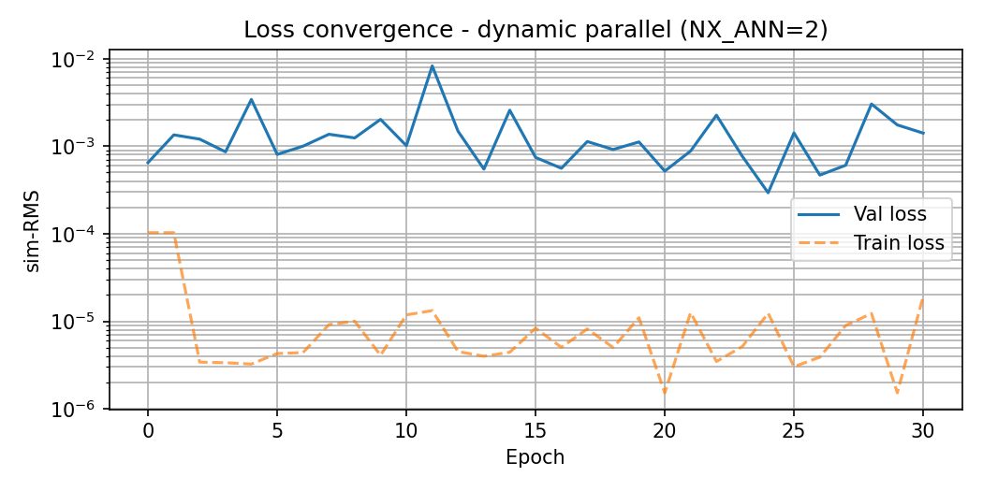

Slide 11
Note: validation sim-RMS so only initial state, but doesn’t converge

Slide 12
=== Sim-NRMS + RMS: augmented vs baseline FP ===
augmented baseline FP improve
(NRMS RMS [m]) (NRMS RMS [m])
X1: 0.0036 2.114e-04 m 0.0034 2.050e-04 m -3.1%
X2: 0.0036 2.325e-04 m 0.0031 2.005e-04 m -15.9%
Y : 0.0017 3.999e-04 m 0.0037 8.492e-04 m +52.9%
Initial Validation sim-RMS= 0.0006494843
Training complete. Best validation sim-RMS: 0.000294

Slide 13
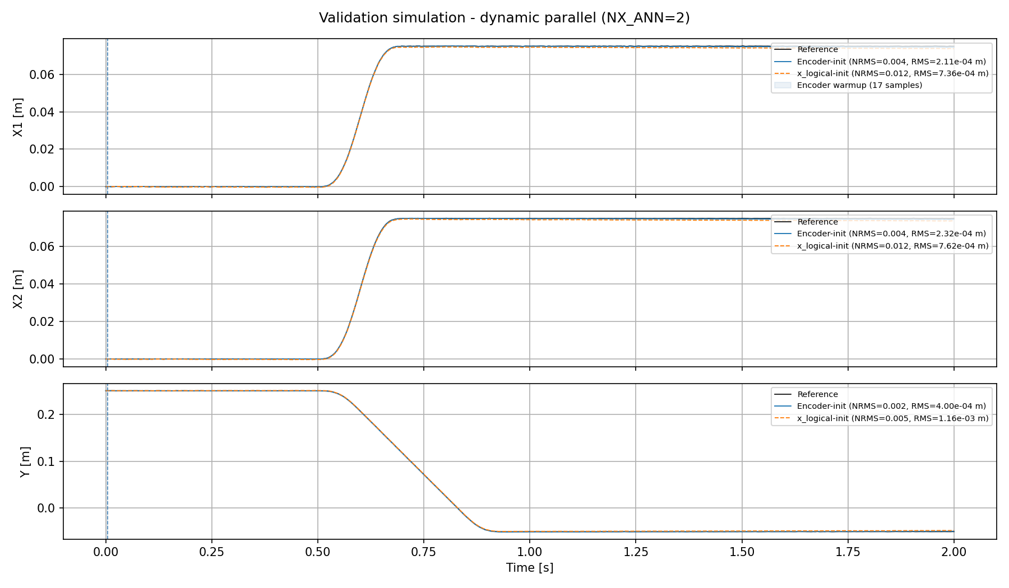
Notes:
Run:= 68676

Slide 14
X_logical init was only for reference
Used the true initial states instead of the encoder for initialization
Notes:
Run:= 68676

Slide 15
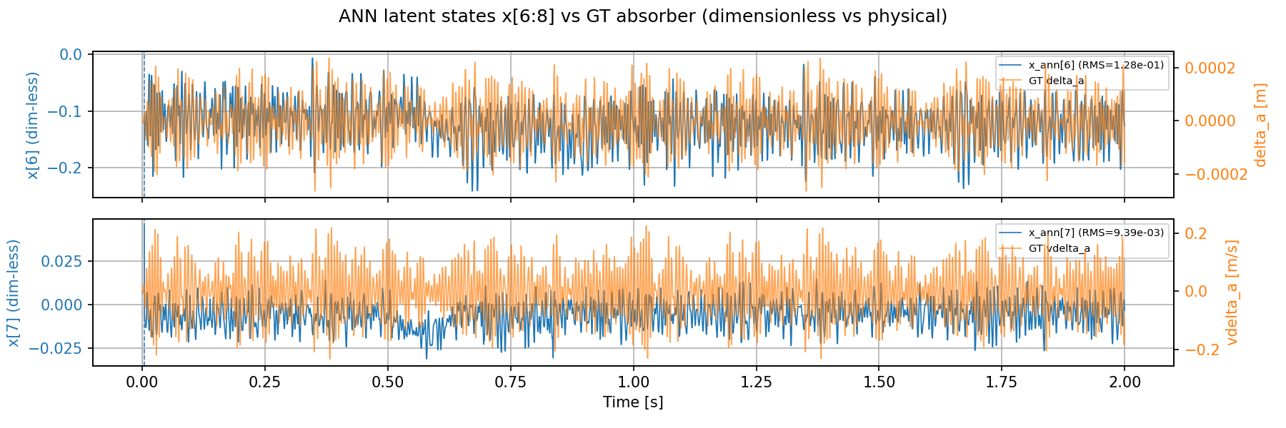
Are the states identifiable?

Slide 16
New data
Frozen-Y standstills, Y-sweeps, randomized jerk-limited setpoint sequences (amplitude ladder), Lissajous
Excitation: reference trajectories (operating-range coverage) + injected random-phase multisine force

Slide 17
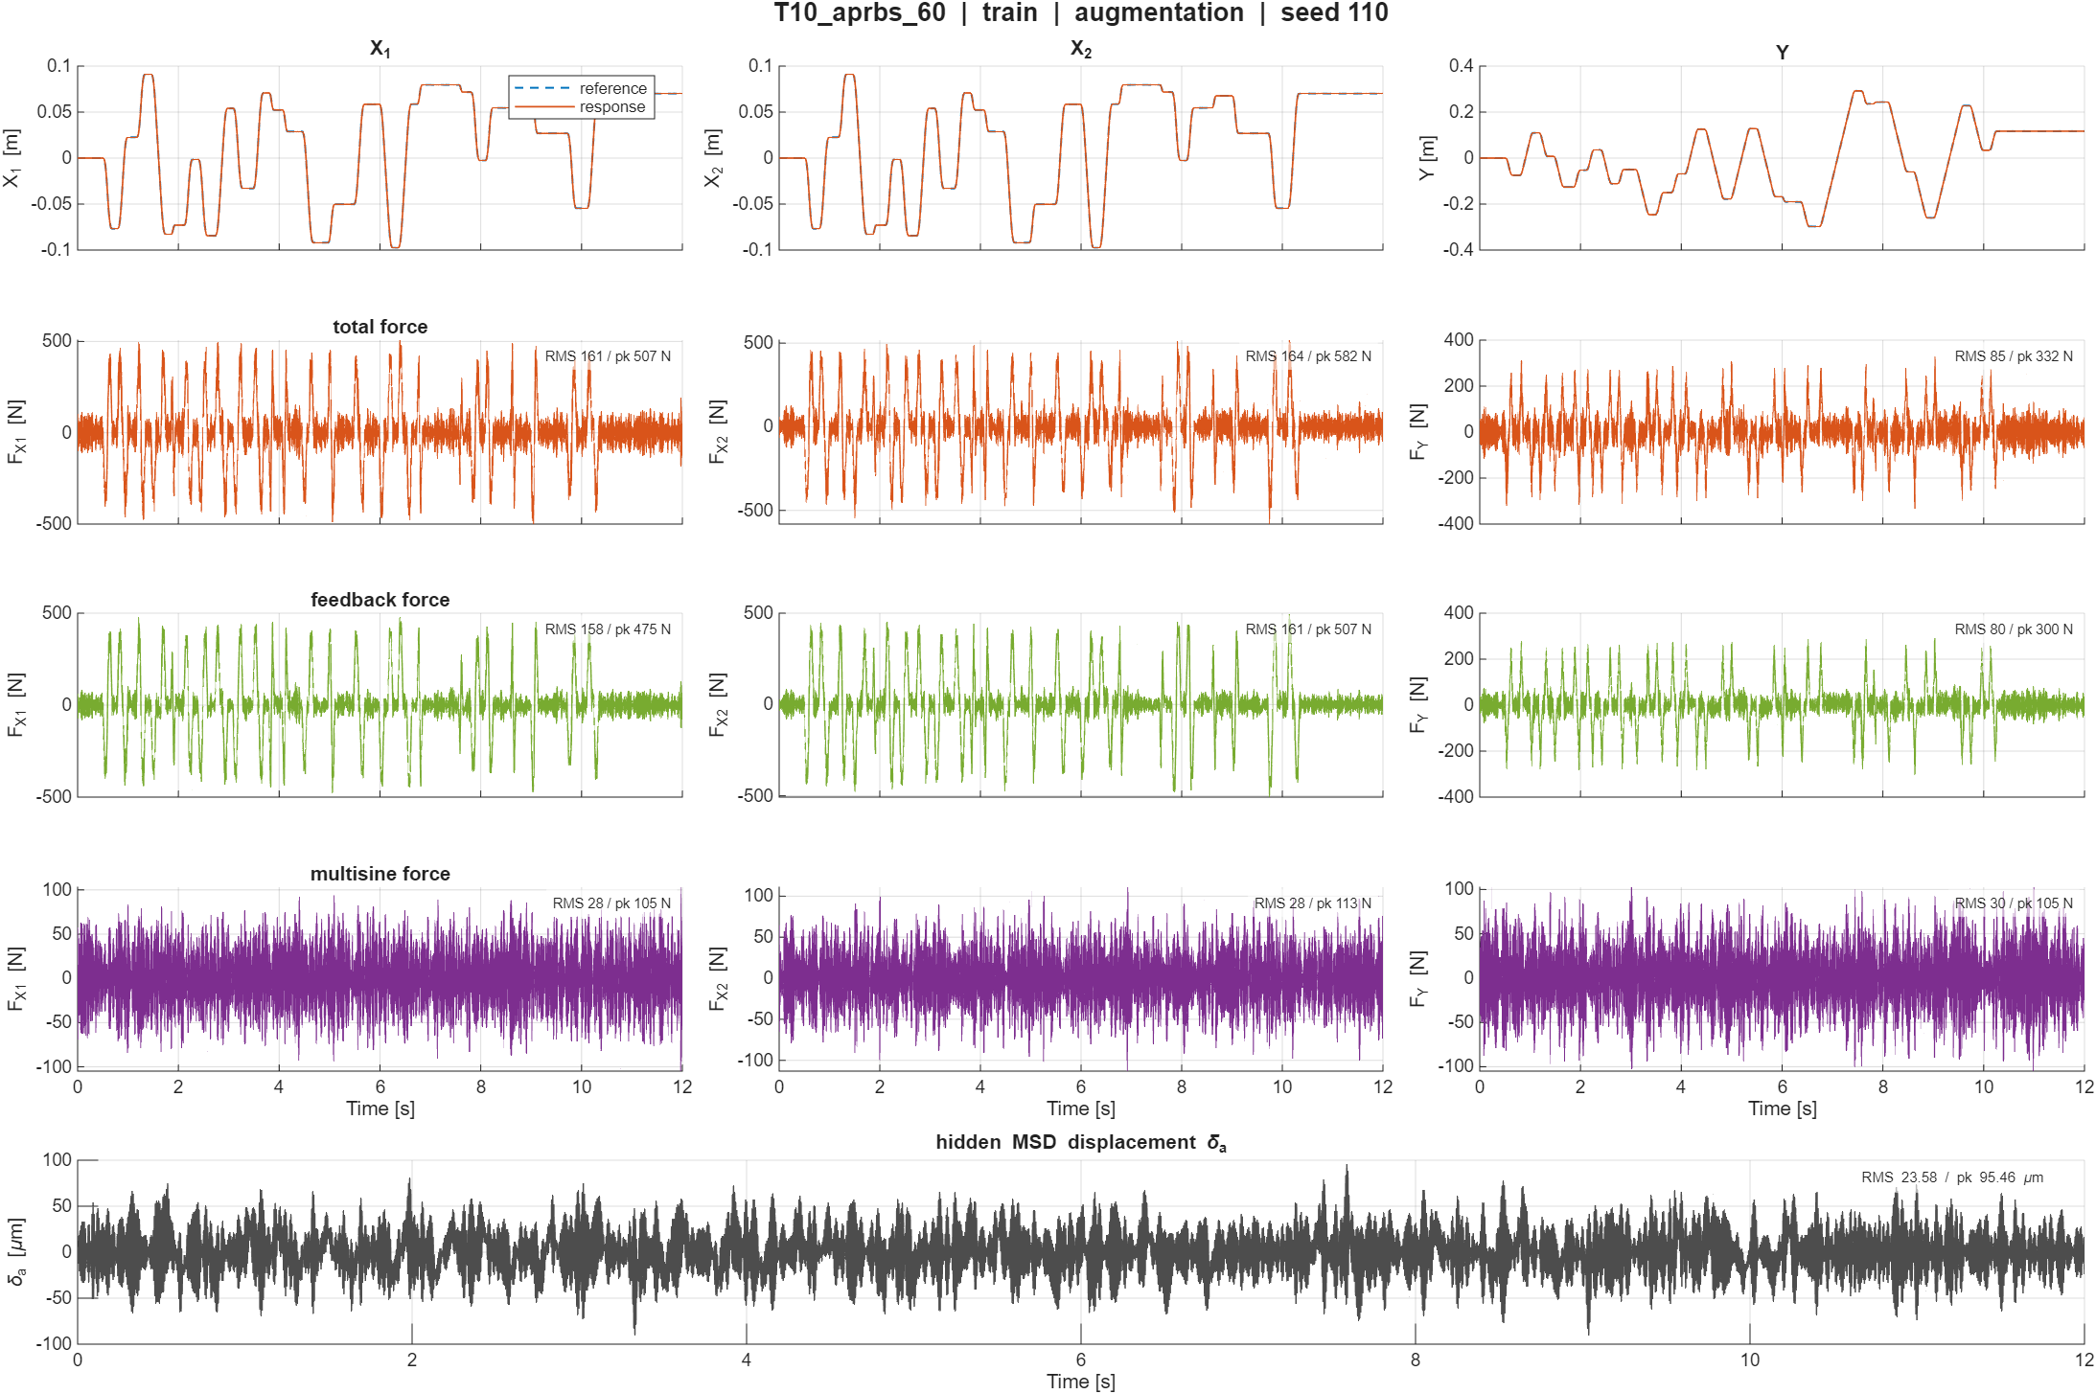

Slide 18
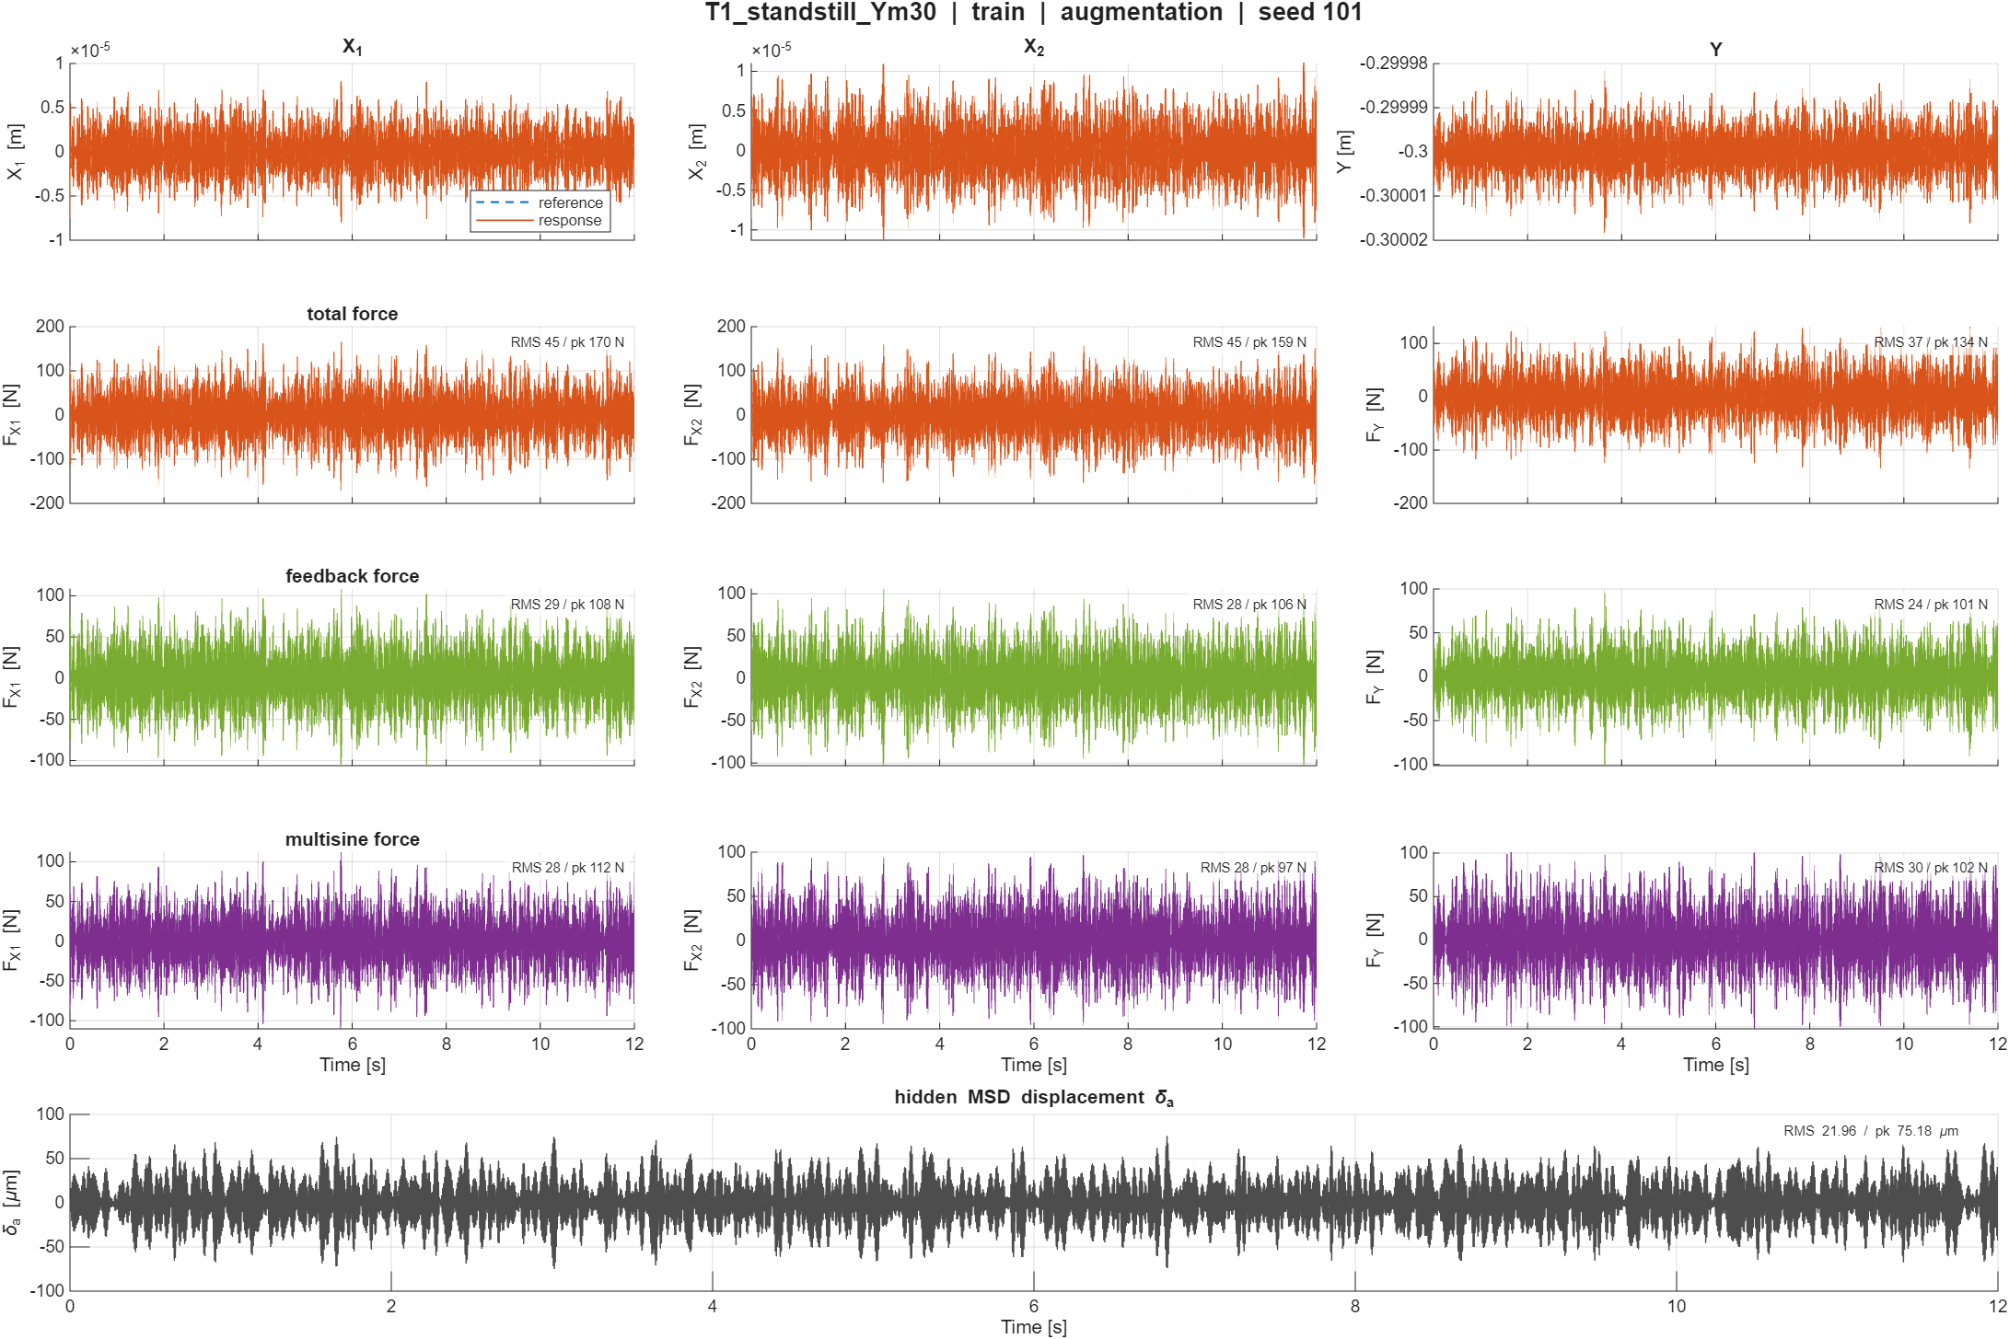

Slide 19
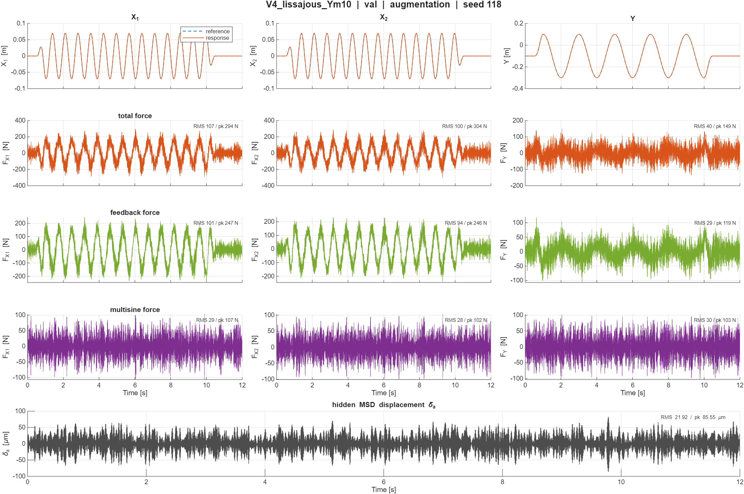

Slide 20
Runtime
Stride
DeepSI allows to pass stride
  So we see all the data but with less overlap

Slide 21
Results new data validation
=== Sim-NRMS + RMS: augmented vs baseline FP ===
augmented baseline FP improve
(NRMS RMS [m]) (NRMS RMS [m])
X1: 0.0009 2.848e-05 m 0.0022 6.959e-05 m +59.1%
X2: 0.0009 2.848e-05 m 0.0022 6.958e-05 m +59.1%
Y : 0.0022 4.108e-04 m 0.0022 4.180e-04 m +1.7%

Slide 22
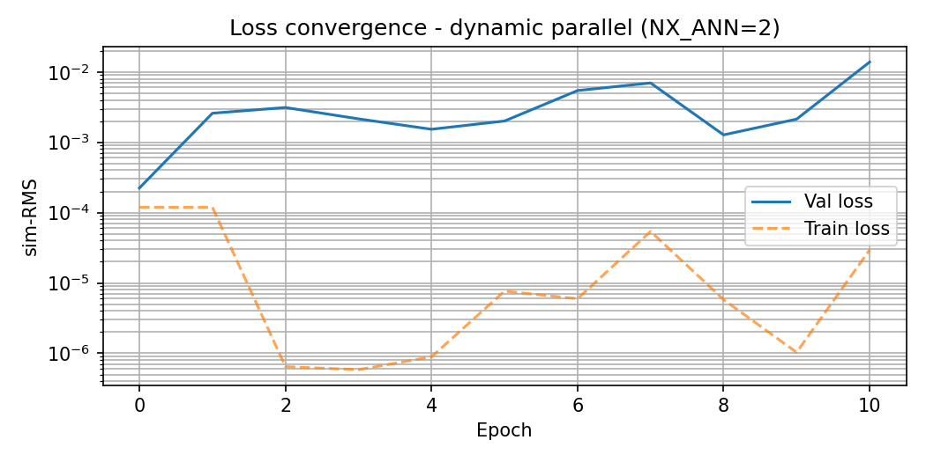

Slide 23
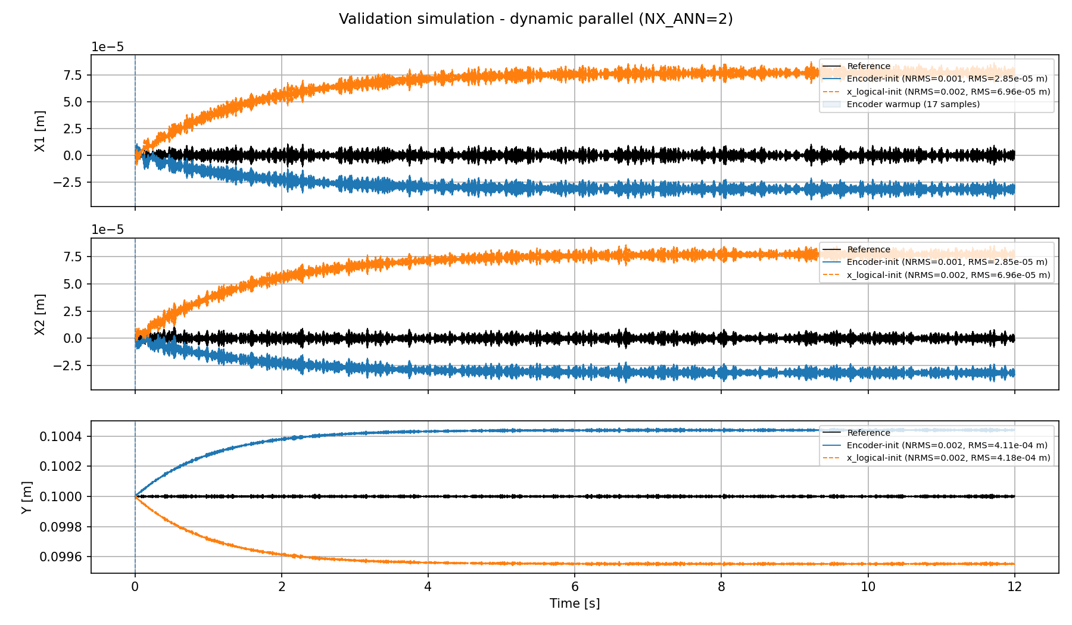
Is this an open-loop problem? Same for the validation loss issue?

Slide 24
=== State recovery diagnostic (D-053) ===
2087 windows (stride 23), na=nb=17, encoder=linear_map
channel R2_raw R2_linmap R2_raw_lag1
q1 +0.9804 +0.9996 +0.9384
q2 +0.9907 +0.9998 +0.9262
q3 +0.7478 +0.8994 +0.8010
dq1 +0.9506 +0.9994 +0.9599
dq2 +0.9765 +0.9996 +0.9681
dq3 +0.4277 +0.8954 +0.6418
R2_linmap ~ 1 & R2_raw low -> basis rotation;
R2_linmap low -> information absent from encoder state;
R2_raw_lag1 > R2_raw -> encoder aligned to k-1 (one-sample lag)

Slide 25
Question
How to interpret augmented states?
  Possible to determine performance?
  Or only model error output and keep physical states interpretable?

Slide 26
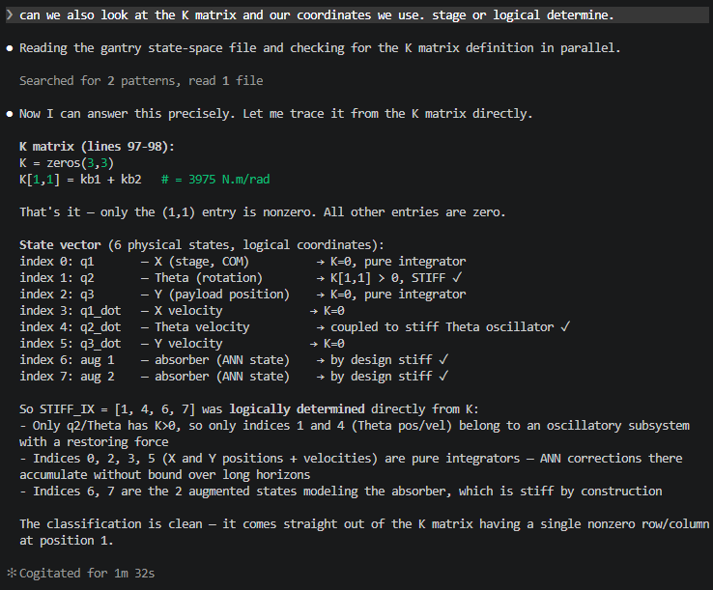
Stiffness only

Slide 27
Previous issue states didn’t learn
K matrix only for Theta rows
Immediate blow up
  I solved this with alternative routing by C_aug. states didn’t learn anything

Slide 28
What to do about y-routing…

Slide 29
When good enough?
→ Reach noisefloor
Advice from Jan add noise and if you reach the noise floor good enough
  Do I determine the amount of noise based on the error the model without MSD is able to achieve?
Notes:
Use the baseline model error to determine the noise

Slide 30
Joint estimation
Reused slides from meeting yesterday ASMPT
Implemented
Currently have only run it for a couple parameters
  All parameters still currently running

Slide 31
Joint estimation
Implemented
Currently have only run it for a couple parameters
  All parameters still currently running
Parameters were identifiable, but error got worse than baseline model

Slide 32
=== Joint estimation: physical parameters (best checkpoint) ===
param init learned delta
kb_sum 4372.5000 4102.0200 -6.19%
cg1 15.9500 15.9632 +0.08%
cg2 18.2700 18.2941 +0.13%
cy 11.0000 10.9747 -0.23%
cb_sum 16.2000 16.0853 -0.71%
=== Sim-NRMS + RMS: augmented vs baseline FP ===
augmented baseline FP improve
(NRMS RMS [m]) (NRMS RMS [m])
X1: 0.1073 6.386e-03 m 0.0034 2.050e-04 m -3014.7%
X2: 0.0991 6.347e-03 m 0.0031 2.005e-04 m -3065.4%
Y : 0.0139 3.196e-03 m 0.0037 8.492e-04 m -276.4%
Initial Validation sim-RMS= 0.0058515198
Best validation sim-RMS: 0.005516

Slide 33
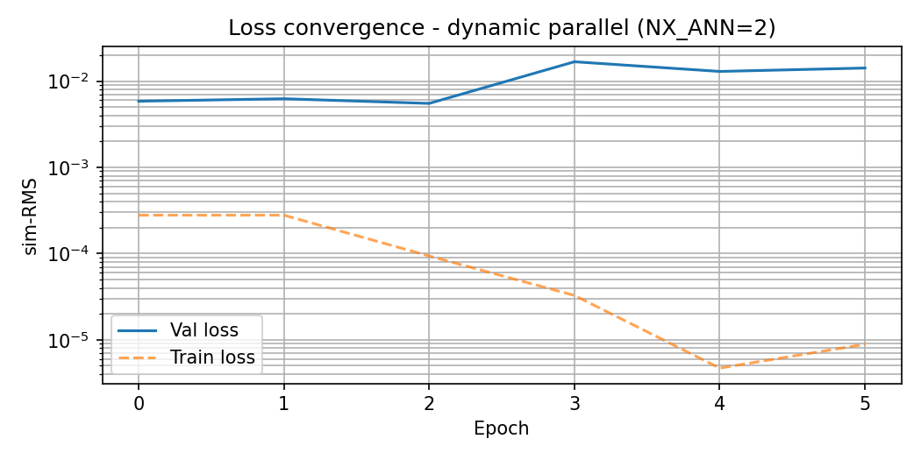

Slide 34
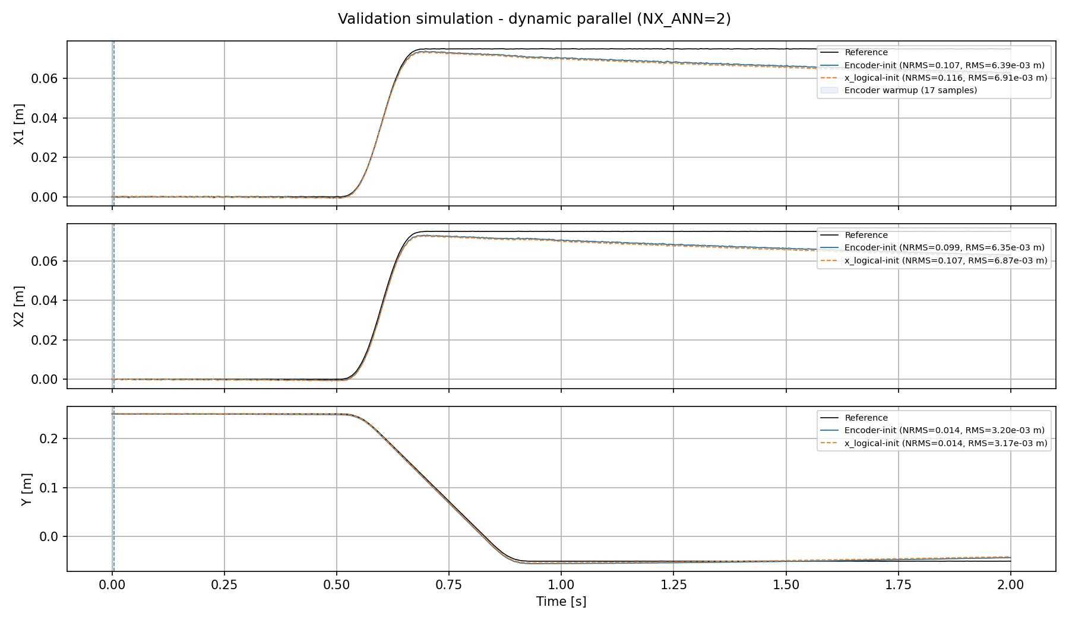

Slide 35
Question
Multisine range for augmentation I use 130-180hz, resonance at 157hz
Should I use for joint estimation 1-200hz due to lower frequent dynamics? (Around 5hz)

Slide 36
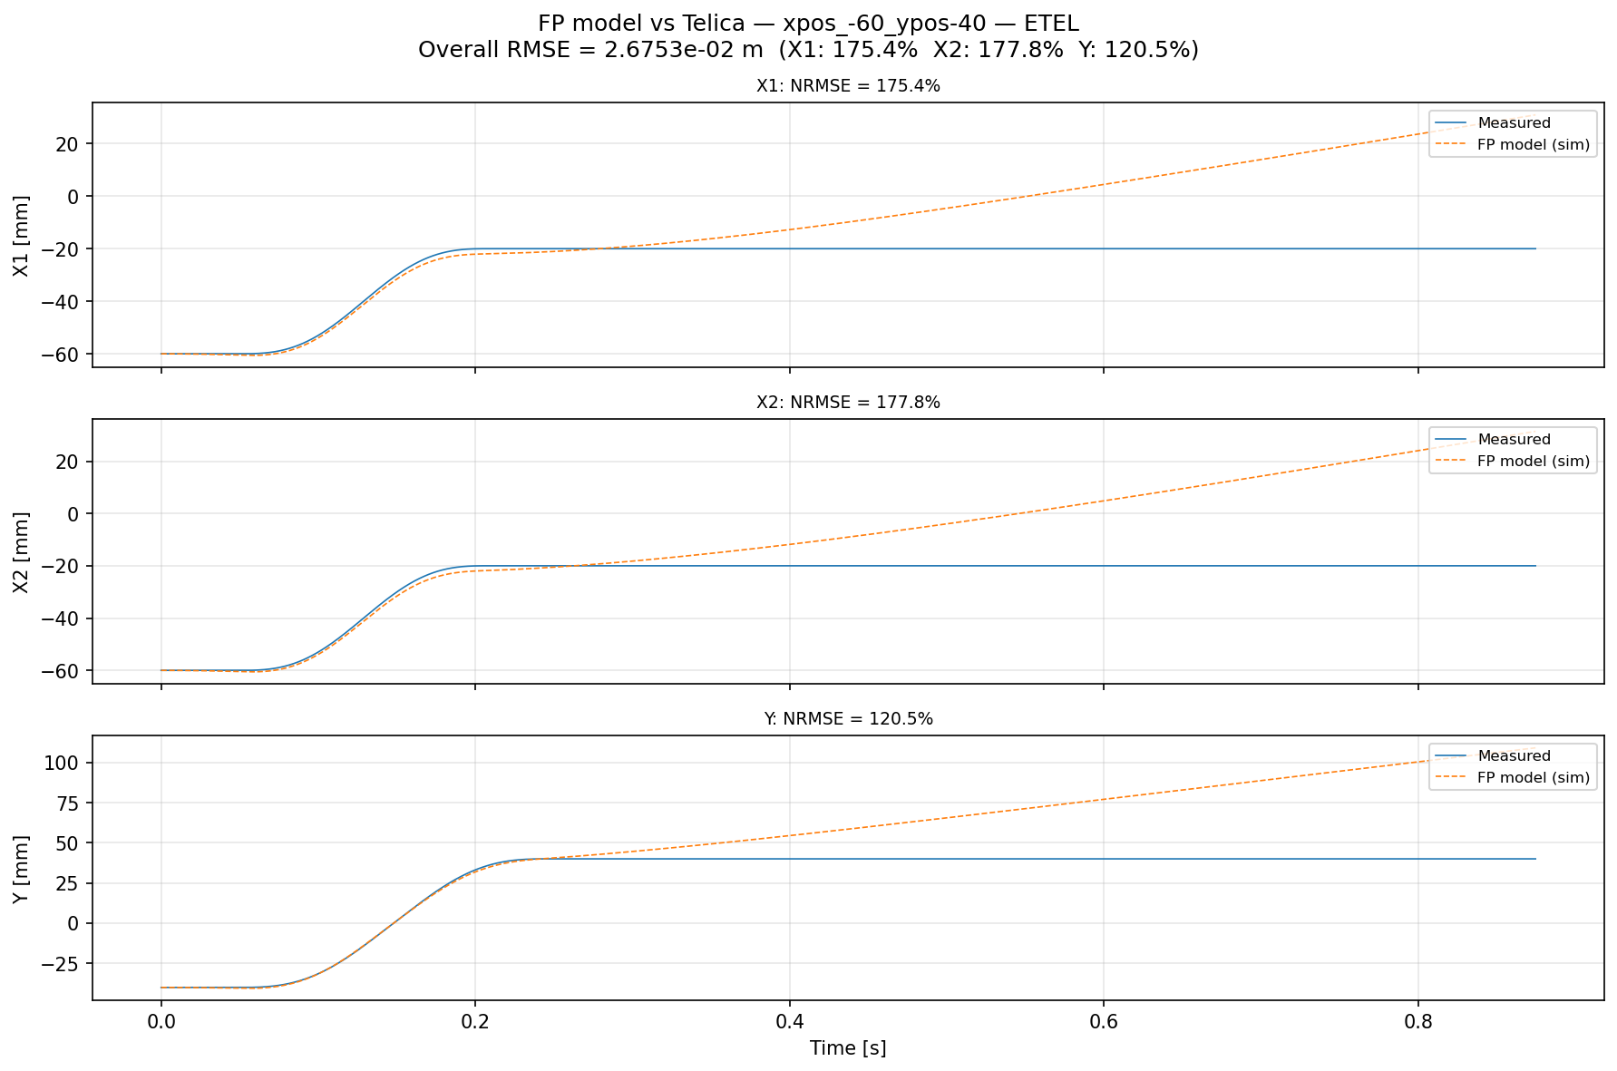
Real data verification
Previously drift off
  Open-loop issue
Solution:
  Re-run fitted model in closed-loop

Slide 37
Real data verification
Previously drift off
  Open-loop issue
Solution:
  Re-run fitted model in closed-loop
  Longer horizon

Slide 38
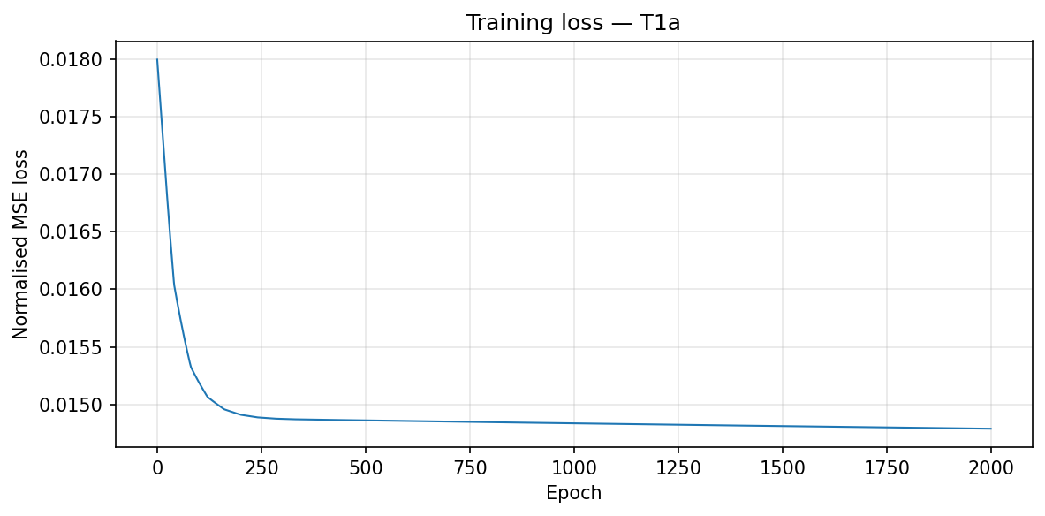
Training loss
Barely moved

Slide 39
Outline next week
First fix that I reach the noise floor for augmentation without joint estimation
  Then with joint estimation
Look into adding orthogonality
  First augmentation needs to be working
  But runs take a long time so before I see results prefer working in parallel

Slide 40
